Slide 1


Camera Geometry
From pixels to the world
13 November
2026

Slide 2
The gap in the pipeline
Two identical boxes
Both have the same ratio of height to distance, so both land on the sensor at the same height. The detector reports the same box.
Everything that tells them apart — distance, real size, position in the room — was discarded the moment the world was projected onto a sensor.
200 px tall
200 px tall
a cup 10 cm tall, 40 cm away
a car 1.5 m tall, 6 m away
13 November
2026
Projection is lossy. Geometry is how you get some of it back.
Notes:
This is the motivating slide. Ask the room how they would recover distance before showing them the model.

Slide 3
Why it matters
A robot grasp
Camera
gives pixels
Video placeholder
Gripper
needs metres
robot picks an object and uses it
In between
camera geometry
13 November
2026
Notes:
Play the clip. Then ask: the camera says the cup is at pixel (412, 230). What does the gripper need? A position in metres, relative to the arm. Intrinsics turn the pixel into a direction. Depth says how far along that direction. Extrinsics say where the camera sits relative to the arm. If any of the three is off by a little, the gripper closes on air.

Slide 4
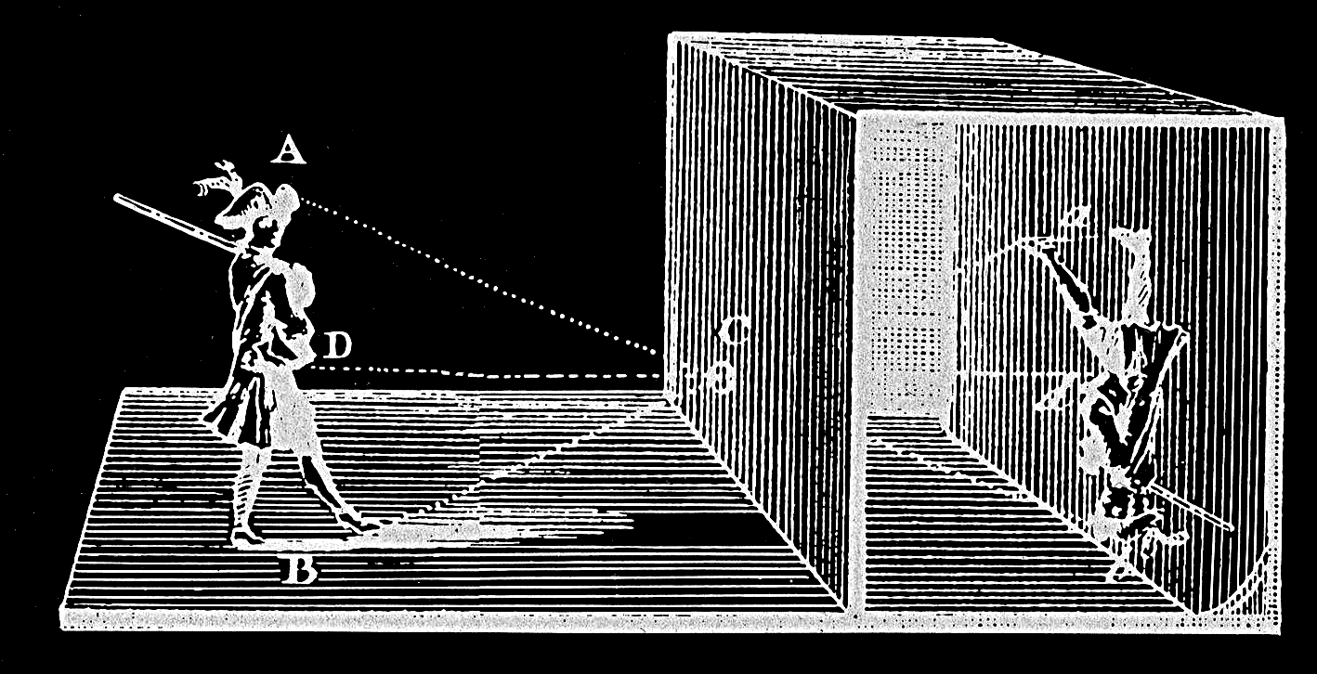
The oldest camera
Camera obscura
13 November
2026
A dark room with a small hole in one wall. Light from outside passes through the hole and draws the scene on the opposite wall, upside down. Every camera since is this room, made smaller.
Notes:
Ibn al-Haytham described this around the year 1000 — they met him in the opening of the 23.10. session. Follow the dotted lines: the ray from the head (A) lands at the bottom of the wall, the ray from the feet (B) at the top. Your phone camera is the same thing with a lens in the hole and a sensor on the wall.

Slide 5
The same room, today
Camera sensor
camera
lens
→
scene
chip, from the side
chip, from the front
13 November
2026
Replace the wall with a chip: a grid of light-sensitive cells, one per pixel. Each cell counts the light that reaches it, and that count is the pixel value. The picture still arrives upside down — the camera flips it for you.
Notes:
A real sensor has millions of cells — 12 megapixels is roughly 4000 by 3000. The cells only measure brightness; a small red, green or blue filter over each one is how colour gets in. And the cells are the ruler: f = 800 px means the lens-to-chip distance equals 800 cell widths.

Slide 6
Projection
The pinhole model
y = f · Y / Z
Y
An object's height in pixels is its real height, scaled by focal length and divided by distance.
Rearranged, it is a measuring tool: if you know two of the three, you get the third. Known object size gives you distance. Known distance gives you size.
This is the whole basis of monocular depth estimation, and the reason it needs an assumption to work at all.
centre of projection
y
sensor
13 November
2026
Z — distance to the object
f

Slide 7
One number
Focal length
short f
long f
13 November
2026
wide view, small image
zoom, large image
Same scene, same hole. Move the back wall away and the picture grows. That distance is the focal length — 1x and 3x on your phone are two values of it.
Notes:
This is the f slider in the simulation. Bigger f, bigger image, without the object moving. From a single photo you cannot tell zoom from walking closer.

Slide 8
The camera itself
Intrinsics
fx, fy
Focal length in pixels. Different in x and y only if the pixels are not square.
cx, cy
The principal point: where the optical axis actually meets the sensor. Rarely the exact centre of the image.
These belong to the camera, not the scene. They do not change when you move it — which is why you measure them once, by calibration, and reuse them.
13 November
2026
Your phone has its own set. So does every camera in this room.

Slide 9
Where the camera stands
Extrinsics
R
Rotation
t
Translation
Which way the camera is pointing. Three degrees of freedom.
Where the camera is. Three more.
Six numbers in total, and they change every time the camera moves. Tracking a camera through a scene means estimating them continuously — which is what visual odometry and SLAM do, and what a headset does a hundred times a second.
13 November
2026

Slide 10
The full chain
World point
Camera frame
Image plane
Pixel
X, Y, Z in metres
→
rotated and shifted by R, t
→
divided by Z
→
scaled by fx, fy, offset by cx, cy
Extrinsics do the first step. Intrinsics do the last. The division by Z in the middle is where depth is thrown away, and it is the only step you cannot undo.
13 November
2026
Stereo, LiDAR and depth estimation are three different ways of putting Z back.

Slide 11
What the model ignores
Lens distortion
Radial distortion pushes points away from or toward the image centre, and it grows with distance from that centre. Wide-angle and action cameras show it plainly.
It is modelled with a few extra coefficients and removed before anything geometric is computed. Skip this step and every measurement you make is wrong at the edges of the frame, where it is hardest to notice.
the model assumes this
the lens gives you this
13 November
2026

Slide 12
A printed sheet of paper
Calibration
Print
A checkerboard with squares of a known size.
Photograph
Fifteen to twenty shots, from varied angles and distances.
Find corners
Sub-pixel corner detection gives precise image coordinates.
Solve
Fit the intrinsics and distortion that best explain all the views at once.
13 November
2026
The quality measure is reprojection error: take the solved parameters, project the known corners back into the image, and see how far off they land. Below one pixel is good.

Slide 13
Why now
What depends on this
Detection
A box is in pixels. Turning it into a position needs intrinsics and a depth assumption.
Tracking
A Kalman filter on pixel coordinates models image motion, not physical motion.
LiDAR fusion
Fusing a point cloud with an image means knowing exactly where one sits relative to the other.
Depth & 3D
The Deep Dive on 11.12. is reconstruction from posed images. Poses are extrinsics.
13 November
2026
A system that cannot say where something is cannot act on it.

Slide 14
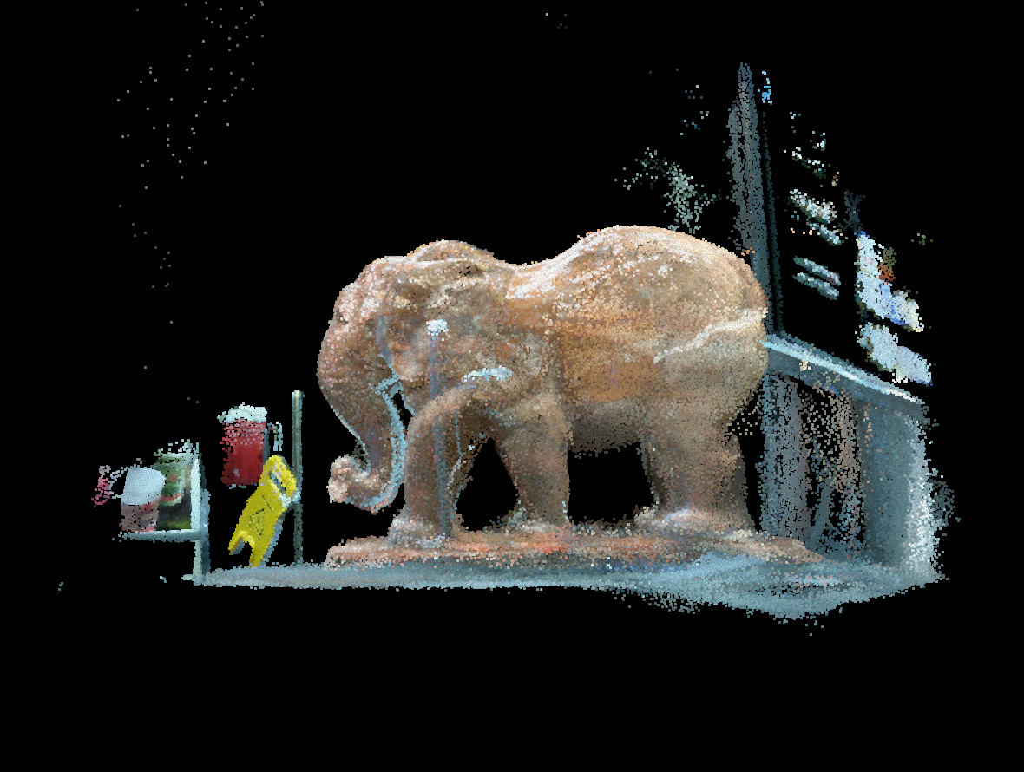
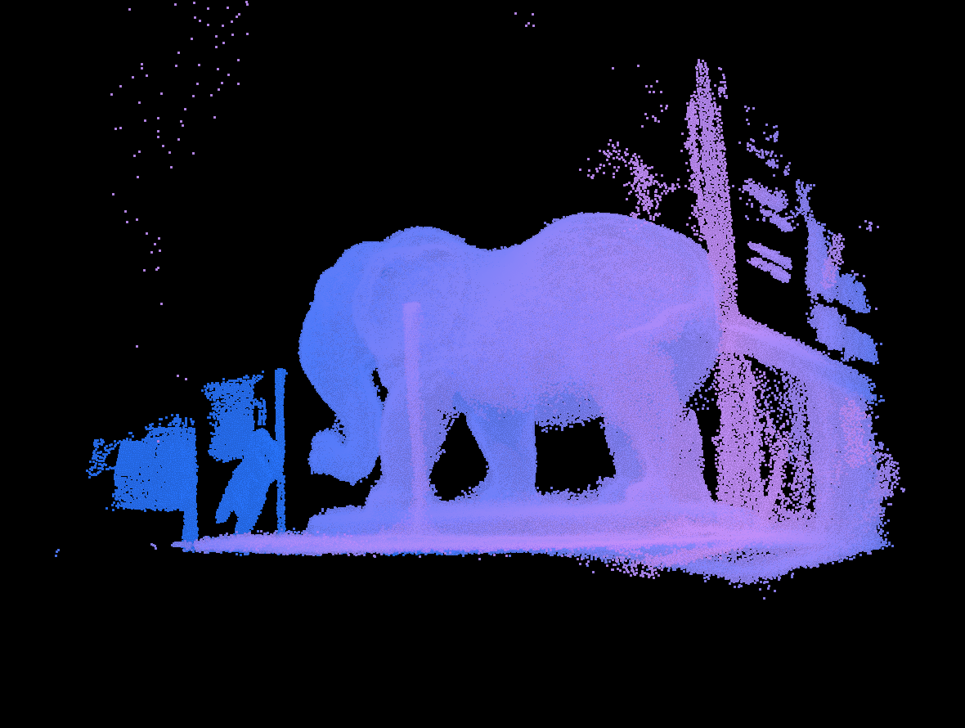
Depth recovered
A point cloud
13 November
2026
colour from the scan
colour by distance from the camera
Half a million points, each one an X, Y and Z in metres. Both pictures are the same cloud put through the same projection you just saw — the only difference is what the colour encodes.
Notes:
This is elephant.ply in the repo, rendered with u = fX/Z and v = fY/Z — the equation from three slides ago, applied half a million times. Note the scan's Y axis points down, which is why it loads upside down if you do not flip it. Getting a coordinate convention wrong is the most common first bug in 3D work.

Slide 15
Practical task
Your own camera
1. Calibrate the camera in your own phone or laptop with a printed checkerboard.
2. Report your fx, fy, cx, cy and your reprojection error.
3. Use the result to measure something: photograph an object of known size and compute its distance, or the reverse.
4. Then find where it breaks. Tilt the object. Move it to the corner of the frame. Zoom. Report the error at each step.
Compare your numbers across the room. No two cameras will agree, and the spread is the point.
13 November
2026
Script: lab02c_calibrate_your_camera.py

Slide 16
Sources
Hartley, R. & Zisserman, A. (2004). Multiple View Geometry in Computer Vision. 2nd ed. Cambridge University Press.
Zhang, Z. (2000). A Flexible New Technique for Camera Calibration. IEEE TPAMI 22(11). — the method behind OpenCV's calibrateCamera
Szeliski, R. (2022). Computer Vision: Algorithms and Applications. 2nd ed. Springer.
Birchfield, S. (2026). Introduction to Computer Vision. arXiv:2609.39627
OpenCV documentation: Camera Calibration and 3D Reconstruction.
13 November
2026
Zhang 2000 is the one to read if you only read one. It is why calibration needs a printed sheet rather than a laboratory.

